Slide 1


2026
2026

Slide 2


A Promised Land of Abundance
EXODUS 3:8a
"And I am come down to deliver them out of the hand of the Egyptians, and to bring them up out of that land unto a good land and a large, unto a land flowing with milk and honey..."
Agribusiness Mandate: Harnessing Nigeria's highly fertile agricultural resources as a promised vehicle for wealth creation.

Slide 3
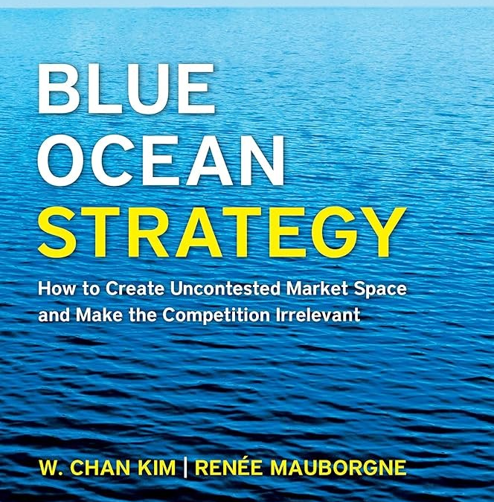
BY
DANIEL GEMANA
YPF FCT PRESISDENT/CEO VERTEX AGRO LTD

Slide 4


Blue Ocean Strategy Foundations
RED OCEAN DYNAMICS
BLUE OCEAN FRONTIERS
The Fight for Market Share
Unlocking Untapped Spaces
Represents traditional industries in existence today. Competitors battle fiercely in overcrowded market spaces, turning the ocean blood-red. Value creation is strictly incremental, focusing primarily on margins, cutting costs, and attempting to beat current competitors on standard parameters.
Denotes industries not in existence today—untapped, clean markets ripe for development. Here, rules are unwritten and competition is completely irrelevant. Value innovation allows forward-thinking enterprises to create a vertical leap in value for buyers, unlocking huge new consumer demand.

Slide 5
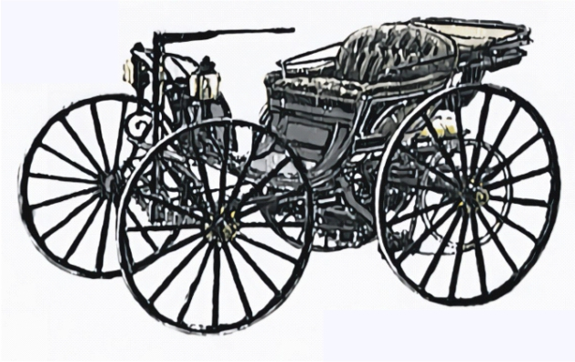
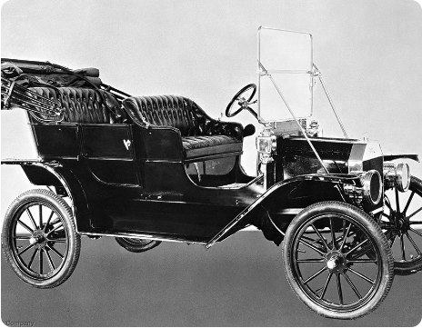
The Great Automotive Disruption
Ford's Historic Blue Ocean Leap
At the turn of the century, horse carriages and highly exclusive custom automobiles defined travel. Ford reinvented the paradigm.
Duryea Custom Car (1893)
Duryea Custom Car (1893): Sold for $1,500 (twice the average American family income). Regarded as a symbol of "arrogant wealth" with extremely limited market viability.
Ford Model T (1908): Positioned as a "car for the great multitude". Scaled via standardized manufacturing (only in black) to drop price from $850 down to $290 by 1924. Market share went up from 9% in 1908 to 61% by 1921. It exploded and created a huge bloc ocean.
Market Explosion: Ford's market share skyrocketed from 9% in 1908 to an incredible 61% by 1921, establishing a robust automotive Blue Ocean.
Ford Model T (1908

Slide 6


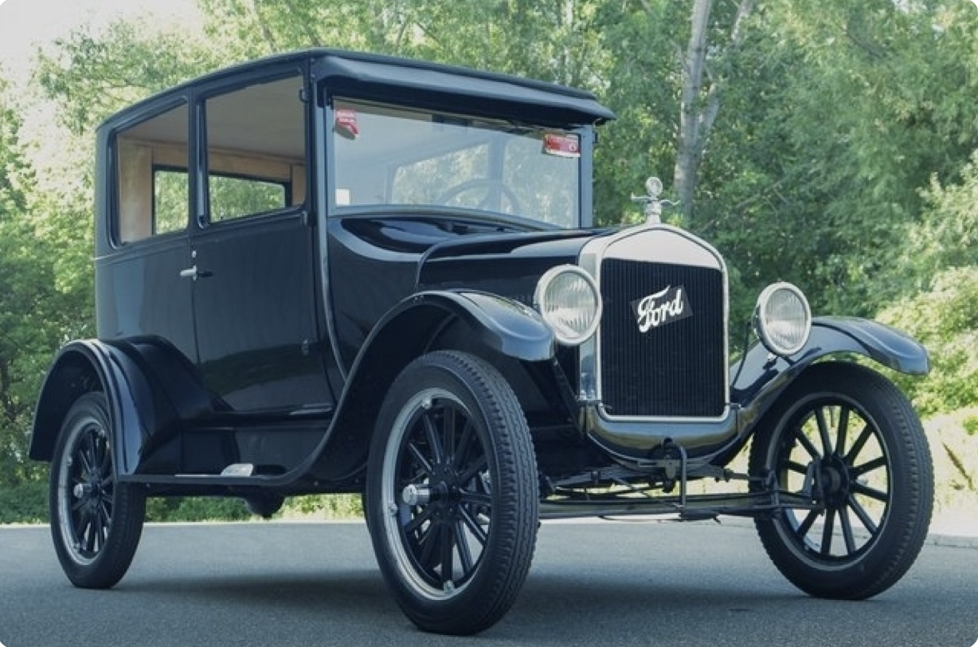
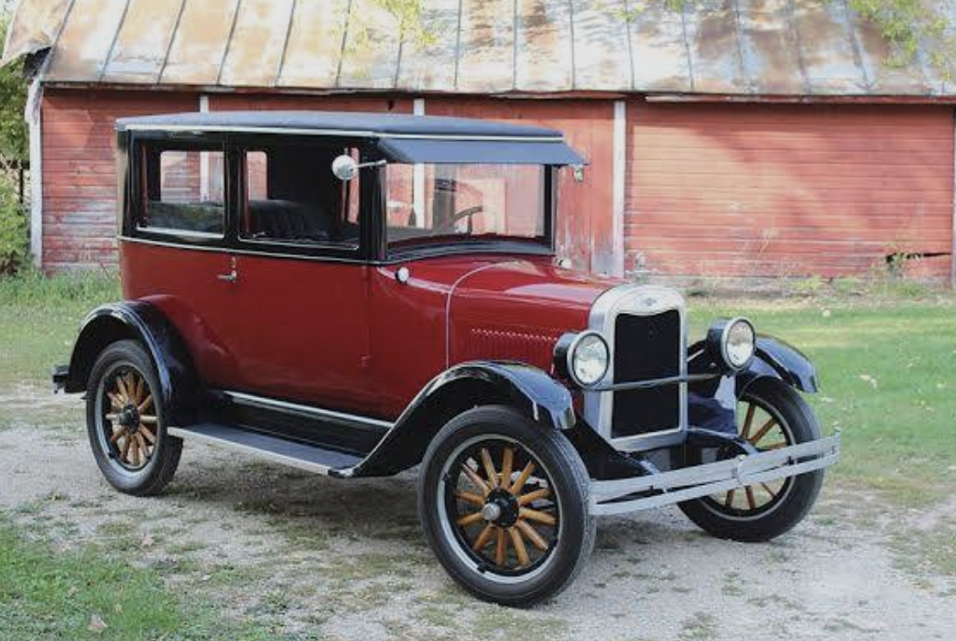
The Standardization Trap
FORD (1926-1950)
GM FASHION CARS
The Over-Standardization Pitfall
Emotional Value Customization
Ford failed to adapt as the market matured, sticking to absolute standardization and resisting variety. As consumers sought emotional value and diverse styling, Ford's refusal to offer choice caused its market share to collapse from 50% down to 20%, converting its Blue Ocean back into a highly competitive Red Ocean.
General Motors recognized the shifting paradigm. By launching fashion-forward cars in multiple vibrant colors and varied models, GM catered to customer emotions and status. This strategic shift in the value curve allowed GM's market share to increase from 20% to 50%, winning the post-war automotive landscape.

Slide 7

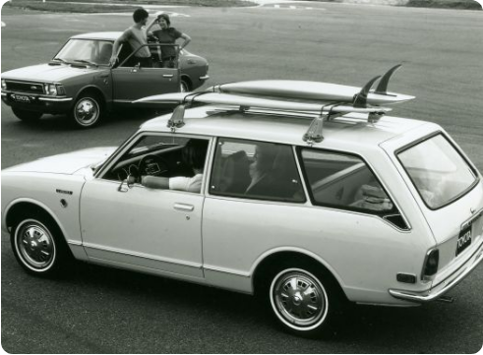
Fuel Crisis & Value Shifts
The 1970s Fuel Crisis Disruption
A sudden global macro shift instantly redefined the automotive competitive landscape, highlighting how rapidly Blue Oceans can change.
Red Ocean Muscle (Ford Mustang 1969): Built on the "bigger is better" philosophy. Massive heavy engines left US manufacturers completely stranded as fuel prices skyrocketed.
Japanese Blue Ocean (Toyota Corolla 1970): Unlocked a fresh segment by offering small, incredibly fuel-efficient, and reliable vehicles. Demand soared, sending the US "Big Three" into a severe spiral.

Slide 8


Blue Oceans in Academic Institutions
STANDARD UNIVERSITIES
HARVARD BUSINESS SCHOOL
The Red Ocean of Exclusivity
Case Studies & Online Inclusivity
Traditional institutions engage in intense, resource-heavy wars to secure top-tier status based on exclusion. They focus on limiting physical campus space (e.g., maintaining a tiny 6% acceptance rate) and relying on static theoretical lectures, competing on the exact same playground for decades.
Harvard redefined educational delivery. In 1920, they created the “Case Study Method”, shifting from generic lectures to simulation of CEO decisions. By 2012, they launched “Harvard + edX”, offering Ivy League courses online for free, instantly reaching “100 million+ global learners” without physical limits.

Slide 9

Financial Freedom in Higher Ed
Strategic Asset Management
Standard University Vulnerability: Dependent heavily on annual tuition cycles and short-term donation targets, forcing them to fight constantly for every operating dollar.
$50B+
HARVARD ENDOWMENT
Harvard's Hedge Fund Model: By treating its massive endowment as a multi-decade hedge fund, Harvard secures complete financial freedom, prioritizing 50-year compound returns.

Slide 10
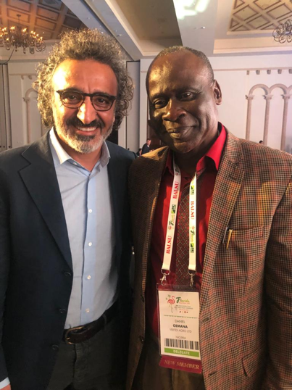
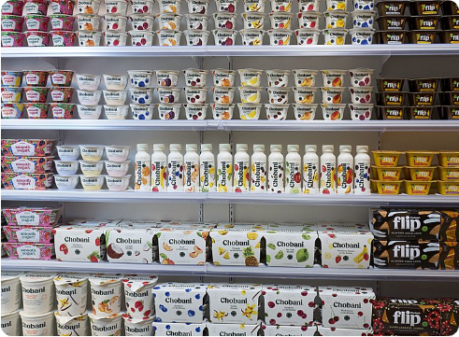
The Chobani Disruption Curve
Hamdi Ulukaya's Blue Ocean
Hamdi Ulukaya
Founder/CEO, Chobani Yoghurt, USA
Chobani entered a heavily consolidated, highly competitive US yogurt market and entirely bypassed traditional dairy competitors.
Traditional Red Ocean: Corporate leaders (Dannon, Yoplait) engaged in margin-diluting battles, producing thin, heavily sweetened, watery yogurts.
Greek Yogurt Blue Ocean: Chobani bypassed flavor options by offering Greek Yogurt: thick, strained, high-protein, and nutrient-dense, capturing health-conscious adults.
Bypassing Specialized Delis: Placed Greek yogurt directly in the main grocery dairy aisle alongside traditional brands, scaling to a billion-dollar company rapidly.

Slide 11
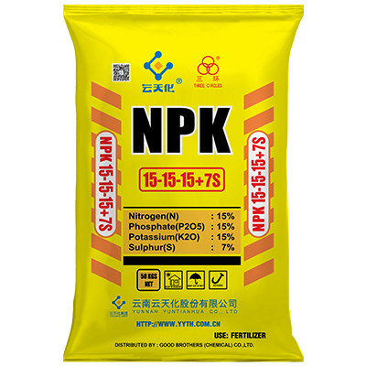
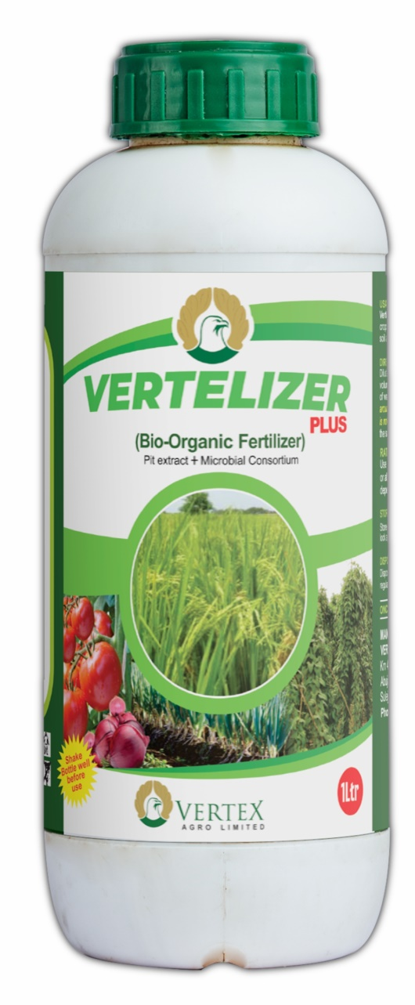

Agri-Chemicals vs. Organic Tech
Strategic Parameter | Chemical NPK Fertilizer | Vertelizer Bio-Organic
Soil Health Impact
Soil Organisms
Environmental Health
Cost per Bag / Bottle | ₦50,000 | ₦5,000 (90% Cost Reduction)
Cost per Hectare | ₦250,000 | ₦25,000 (90% Cost Reduction)

Slide 12
SUCCESS NUGGETS
Vision & passion can be born and maintained by prayer.
Innovations/Inventions are born and maintained in a sublime, quiet environment of prayer and meditation.
1Tim.4: 15. Meditate upon these things; give thyself wholly to them; that thy profiting may appear to all.
Unprecedented achievement in life is not for everyone – there is an unprecedented price to pay.
No meaningful breakthrough without breakdown.
Behind every disappointment lays lies a blessing, and behind every adversity a disguised treasure
– Singapore/Malay.
Success does not depend on where you come from – it depends on the stuff you are made of .

Slide 13


